Slide 1
MMA 801 – Introduction to Management Session Four – Marketing Fundamentals
Master of Management in Analytics
May 15, 2020
Gary J. Bissonette

Slide 2
MMA 801 – Session 4
Today's Agenda
Agenda Item | Section 1 (Morning) | Section 2 (Afternoon)
Assignment #1 & #2 – Orientation | 8:30 am – 8:50 am | 1:00 pm – 1:20 pm
Marketing Fundamentals | 8:50 am – 9:50 am | 1:20 pm – 2:20 pm
Netflix Case – Breakout Room Exercise | 9:50 am – 11:30 am | 2:20 pm – 4:00 pm
Netflix – Team Presentation & Debriefing | 11:30 am – 12:00 pm | 4:00 pm – 4:30 pm

Slide 3
MMA 801 – Session 4
Course Deliverables – Assignment Information is Posted to Course Website
Assignment #1 – Team-based Case – 35% of MMA 801 Final Grade
Team-based Presentation with Slide Deck
Submission – Electronically to Course "Dropbox"
Slide Deck Submission Due Date:
24 hours prior to your team's presentation
Team Presentations (via Zoom):
As mutually agreed upon…between May 23rd and June 2nd, 2020

Slide 4
MMA 801 – Session 4
Assignment #2
Reflection: Page Maximum – 7 pages, double-space, 11-point font
Exhibits – 7 additional pages
Cover Page and End Note page (if applicable) not part of the 6-page count
You are writing in the first person – reflection or opinion-based paper
Due Date – June 19, 2020 – 11:59 pm. Upload to Dropbox. Cover page required.
Formal "Guidance Document" located on course website – <Assignments> or <Dropbox>

Slide 5
MMA 801 – Session 4
Assignment
3 Approaches/Options
Reflection – Prepare a reflective commentary on the extent that analytics and/or AI (Artificial Intelligence) is being used/ leveraged by your organization, division or department, unit, etc.
Delta Framework approach is optional…alternate frameworks are okay.
Canadian Business Article – The focus of the article is on educating its readership on the fundamentals of business analytics.
Customized Project Path (white paper, project plan, etc.) – Verbal or email approval required.

Slide 6
MMA 801 – Session 3
Option #2 – Theme Examples
Analytics and Covid-19
Using Analytics for Business Decision-Making Purposes
"Evolution of Analytics from an Information Tool to that of a Required Core Functionality" within an organization
How artificial intelligence is changing business processes
How artificial intelligence is changing a particular industry (automotive, health care, financial services, etc.
The utilization of "Chatbots" and their disruptive potential with respect to communication
How artificial intelligence is changing the job market
Artificial intelligence activities within one of the big technology companies

Slide 7
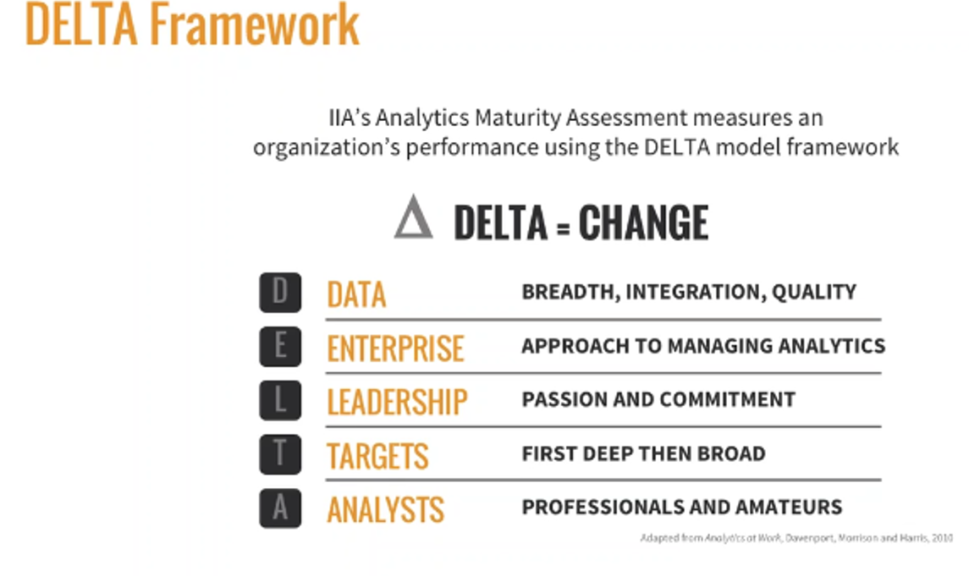
MMA 801 – Session 4
Optional Framework

Slide 8

Analytical Maturity Model (DELTA)
DATA ENTERPRISE LEADERSHIP TARGETS ANALYSTS
STAGE 5
Analytical Competitors
Relentless search for new data and metrics
All key analytical resources centrally managed
Strong leadership passion for analytical competition
Analytics support the firm's distinctive capability and strategy
World‐class professional analysts and attention to analytical amateurs
STAGE 4
Analytical Companies
Integrated, accurate, common data in central warehouse
Key data, technology and analysts are centralized or networked
Leadership support for analytical competence
Analytical activity centered on a few key domains
Highly capable analysts in central or networked organization
STAGE 3
Analytical Aspirations
Organization beginning to create centralized data repository
Early stages of an enterprise‐wide approach
Leaders beginning to recognize importance of analytics
Analytical efforts coalescing behind a small set of targets
Influx of analysts in key target areas
STAGE 2
Localized Analytics
Data useable, but in functional or process silos
Islands of data, technology, and expertise
Only at the function or process level
Multiple disconnected targets that may not be strategically important
Isolated pockets of analysts with no communication
STAGE 1
Analytically Impaired
Inconsistent, poor quality, poorly organized
n/a
No awareness or interest
n/a
Few skills, and these attached to specific functions
Adopted from the Five Stages of Analytics Maturity developed by Tom Davenport and Jeanne Harris in their book, Competing on Analytics: The New Science of Winning, and the DELTA Model developed in 2010 by Tom Davenport, Jeanne Harris and Bob Morison in their book, Analytics at Work: Smarter Decisions, Better Results.

Slide 9
MMA 801 – Session 4
Assignment Assessment
Grade Value – 65% of grade
Requirement – must receive a passing grade on Assignment #2 to pass the course. Course is graded on a "Letter Grade" basis.
Assessment – equal weighting on content and communication delivery. Think in terms of:
Message intent – write from the perspective of a core outcome objective
Delivery style
Structure for delivery, ease of review, and holding interest
Executive Summary is fine, but not required – be sure to frame the discussion at the front end of the paper
Assessment emphasis (Content) – conclusions/outcome validation – does the story make sense?

Slide 10
MMA 801 – Session 4
Business Model Composition
Narrative Test – Your Story
Company-Centric Analysis
Positioning
Market-Centric Analysis
Key Partners
(Backward and Forward… dependencies)
Key Activities
(Value Chain)
Portfolio of Products and Services
Available Customer Segments
(Primary and secondary, size, penetration potential)
Value Proposition
Key Resources
(Composition and velocity)
Customer Relationships
Opportunity Assessment
Market Logic
Underlying Cost Model
(Cost structure and drivers,
scale potential, BEP, etc., capitalization requirements, COC)
Revenue Model
(volume, scope, purchase frequency, sales augmentation, COC, capitalization consumption, ASP degradation)
Culture, Structure and Mgmt. Systems
Adapted from: Business Model Generation, Osterwalder, Pigneur

Slide 11
MMA 801 – Session 4
Revisiting the Profit Model
Product Innovation
Price Strategies
Product Quality
Marketing Effort
Margin
Process Innovation
Cost Strategies
Functional Efficiencies
Discretionary Spending
Net Income
Integration
Marketing Effort
Market Share
Strategies
Customer Value
Barriers to Entry
Volume
New Products
Market Size
Strategies
New Markets
More Usage Occasions
More Usage Per Occasion

Slide 12
MMA 801 – Session 4
Analytics and Profit Model
Data, Judgement, Actions
Looking to reduce the costs of inputs (prediction)
Recognize and articulate the "ripple" effect of input reduction
Define and Increase the predicted value of outputs
Think beyond operational efficiency to business model transformation
Price Strategies
Margin
Cost Strategies
The critical component here is prediction accuracy…do you know what to predict?
Net Income
Can we increase EBITDA by x%
Market Share
Strategies
Volume
Market Size
Strategies

Slide 13
MMA 801 – Session 4
What is an organization's greatest business risk?
It is having a limited understanding of, or an incorrect view of what customers want.
Given the rate at which markets are changing, developing a "best" understanding of what customers want is a strategic necessity.
The question is, how to develop this understanding. Best practice companies (Unilever, Phillips, Amazon, Netflix, etc. generate this understanding through "privileged insight", versus the traditional approach of focus groups, interviews, and surveys.
Privilege Insight – is a discovery or core understanding of what motivates customers, how they shop, and what they need, in making purchase decisions, which enables a company to create value for the customer and the business.

Slide 14
MMA 801 – Session 4
5 Key Ways to Drive "Privileged Insight"
Observe customers in the field – what they do is far more meaningful then what they say
Digitize the daily diary – mobilize it
Use advanced analytics to granulate
Listen and learn with Social Media
Co-create with customers via digital platforms
The value of privileged or strategic insight is…
Not to collect information to make plans, but to
Use that information to generate insights that in turn support ever-changing perspectives
These insights result in management learning which then is translated into action

Slide 15
Marketing fundamentals
MMA 801

Slide 16
MMA 801 – Session 4
What is the role of "Marketing"?
In simple terms…create, communicate and reinforce value
More concretely…
Define the breadth, depth, and frequency of a need (demand creation)
Granulate the market around key decision criteria and applicable weightings
Determine the "value cord" behind the motive to purchase
Create a profile of the customer who is to be targeted
Design the framework for delivery to the market which targets the right set of customers
Execute in a way which drives recognition, preference, loyalty and, ultimately, commitment (demand capture)

Slide 17
MMA 801 – Session 4
Reality is…hence the challenge
Not all customers want the same thing, therefore the same product will not be equally attractive to all customers.
This means that "perfect fit" products with some customers will possess some level of gaps (minor or significant) for others.
This also means that your sales potential and adoption costs will vary across various customer segments.

Slide 18
MMA 801 – Session 4
As suppliers, our problem is two-fold…
Core Problem – Challenge
Since different customers want different things, which customers want what?
How can we provide value, which is determined to be superior to our competitors, and preserve profitability at the same time?
Do you have the "insight" to know the answers to these two questions?

Slide 19
MMA 801 – Session 4
Marketing Process – Responding to the Dilemma
Framework Development and Execution
Marketing Research
Segmentation
Target Market Selection
Value Proposition Development and Profiling (Positioning)
Marketing Mix Development
Message rifling and concentration
Value Curve Positioning
Need/Opportunity Assessment and Value Curve Understanding
Evaluate and Adjust
Right Need & Fit
Right Solution – P/Q Relationship
Right Connection
Right Message
Privileged Insight – Analytics "Touch Points"?

Slide 20
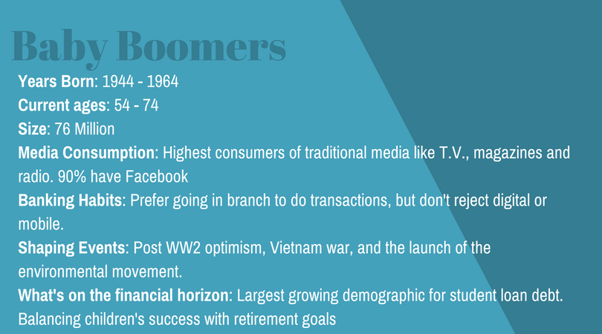
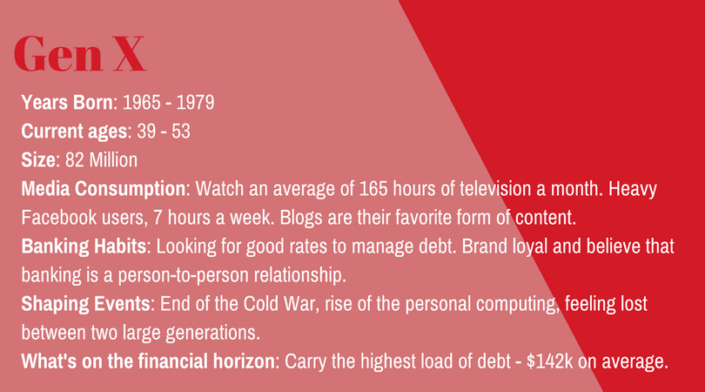
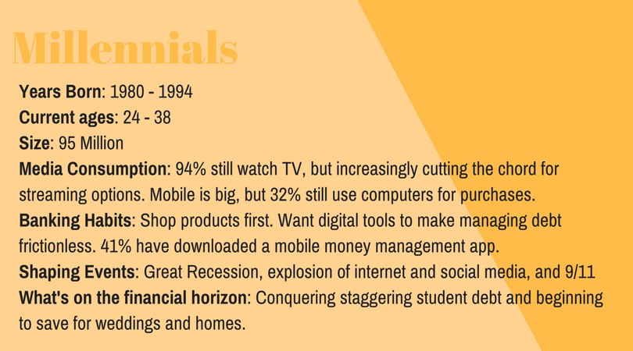
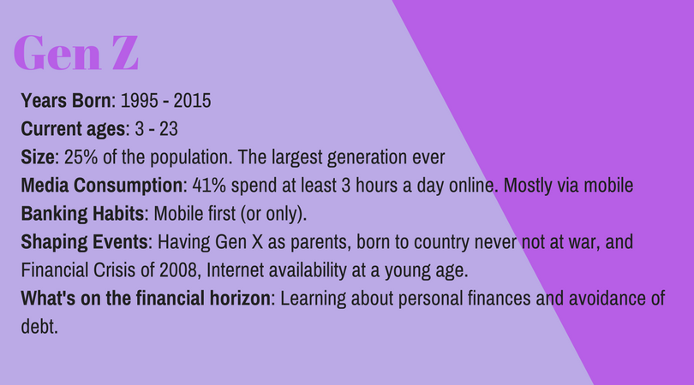
MMA 801 – Session 4
Who, How and Where Do We Target?
Source: Kasasa Marketing

Slide 21

MMA 801 – Session 4
Linking Value Curve Work to the Value Proposition
Customer Profile – Who is our target customer?
Our customer is a busy self-employed or entrepreneurial-focused business professional who leads a hectic and busy life, yet seeks frequent time-outs to relax and recharge his/her batteries. Given the responsibilities which come with their chosen career paths, these individuals need to remain in close proximity to their businesses and/or professions.
This customer is looking for an easy, hassle-free getaway for himself/herself and their families, and wants to be pampered with the luxuries of life during these getaways. As our customer is busy, the ability to be flexible in the scheduling process is necessary, as is the ability to provide efficient, easy-to-use mechanisms for last-minute changes. Our customer is active, seeking a variety of outdoor experiences, as he/she is trying to cram into their short visits a maximum amount of "value", almost on a per minute basis. Having said this, our customer is also about down time and quiet time, and feels a connection with nature and its beauty.
Our customer possesses some knowledge of the Rideau Lakes Region and the historical amenities and beauty which the region offers. Westport and all of its charm is known to our customer and is a drawing card to the purchase process.

Slide 22
MMA 801 – Session 4
At the end of the day…can you create this for NetFlix and McDonald's?
Value Proposition Statement
Part 1 of the Statement
For (the target market)
Who want (the consumer need)
Our products/services are (demonstration of the solution)
That features (key benefits provided)
Part 2 of the Statement
Unlike (our main competitors)
Our product provides (key points of differences)
As supported by (what makes our differences possible)
And protected by (why the competition cannot easily overcome it)

Slide 23
MMA 801 – Session 4
Analytics, AI and Profit Model
Data, Judgement, Actions
Looking to reduce the costs of inputs (prediction)
Recognize and articulate the "ripple" effect of input reduction
Define and Increase the predicted value of outputs
Think beyond operational efficiency to business model transformation
Price Strategies
Margin
Cost Strategies
The critical component here is prediction accuracy…do you know what to predict?
Net Income
Can we increase EBITDA by x%
Market Share
Strategies
Volume
Market Size
Strategies

Slide 24
Positioning, Value Curves and Value Cords

Slide 25
MMA 801 – Session 4
What, in your opinion is the difference between "Positioning" and "Market Position"?
Positioning – is the development of a perception/conclusion, pertaining to your product/service offering, as a unique/preferred solution to a given need, within respect to the customer. It is the valued place you want to own in the customer's mind.
Market Position – is the position of your product/service offering, relative to rivals/competitors, seeking demand capture within the same market space.

Slide 26
MMA 801 – Session 4
Market Position
To position, within a defined market space, we need to know four fundamental things about the customers we are choosing to pursue:
What purchase criteria do customers use in selecting a product/service supplier (value curve)?
What is the prioritization and relative weight of each of these criteria (key value curve component)?
How do we perform, relative to rivals, on the key criteria identified and valued?
What are the gaps between what targeted customers want and what we offer? Is there an opportunity to disrupt?

Slide 27
MMA 801 – Session 4
How do you align positioning with "market position"
Segmentation, Granulation and Target Market Identification
Value Curve Attribute Identification…Critical Cord Analysis
Customer Profiling

Slide 28
MMA 801 – Session 4
What is the difference and the related inter-dependencies between the following:
Market Segmentation
Market Granulation
Target Marketing

Slide 29
MMA 801 – Session 4
Positioning – Striking the Cord…Segmentation, Value Curve and Cord Analysis
Value Curve Attribute Assessment
Service
Emotion
Physical Product
Behavioural
Cost
Lifestyle

Slide 30
MMA 801 – Session 4
Core Critical Components to Target Market Selection
Value Curve Identification
Value Cord Recognition
Decision-Making Path to Recognition, Evaluation, Adoption and Retention
Target Market Customer Profile Visualization
Value Conclusions and Value Proposition Development
White Space Identification and Positioning Conclusions
Communication Message Development
Business Model Alignment Audit

Slide 31
MMA 801 – Session 4
Value Curve and Cord Development
Technique is to "map" current markets around a broad range of analytical methodologies
Consumer segmentation and granulation analytics (value curve?)
Purchase situation analysis
Consumption analysis
Direct competitor analysis
Indirect competitor analysis
Analysis of complementary products and services
Analysis of related industries
Analysis of broader environmental influences (PESTEL)

Slide 32
MMA 801 – Session 4
Two key risks of Value Curve Inertia (Marketing Inertia)
Static Value Curve Alignment
Red Ocean Competition Mentality – Head-to-Head Competition

Slide 33
MMA 801 – Session 4
Value Management Perceptions
Value
Customer Perceived Benefits – Customer Perceived Price
The higher the perceived benefit, and/or the lower the price charged, the higher the value
Static Market Share
Value Equivalence Line (VEL) = Benefits versus Price Positioning
Value Map
Value Disadvantaged
A
B
C
Value Advantaged
Perceived Price
D
E
Customer Perceived Benefits

Slide 34
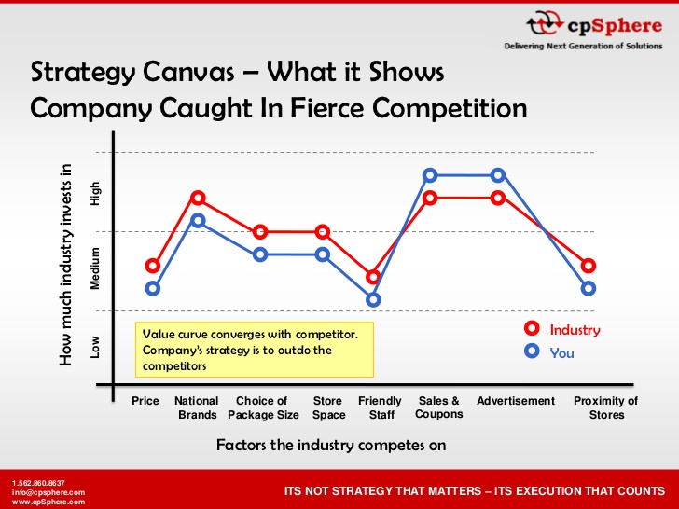
MMA 801 – Session 4
Defining Red Ocean Environments – Think Fitbit vs. Apple

Slide 35
Example – Apple – iPhone Launch
MMA 801

Slide 36
MMA 801 – Session 4
Simplifying Value Curve Attribute Analysis
Eliminate
Raise
Reduce
Create

Slide 37
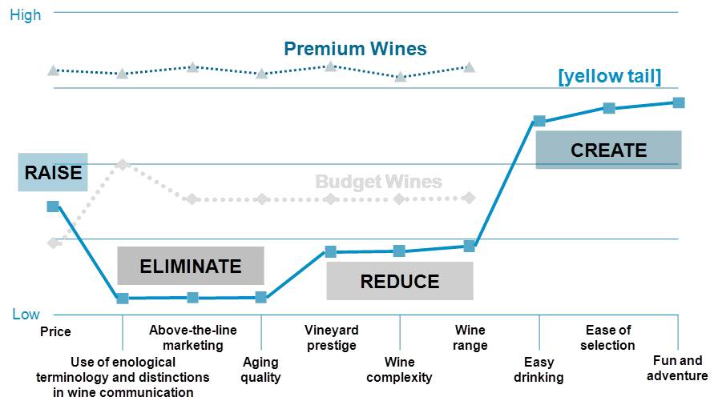
MMA 801 – Session 4

Slide 38
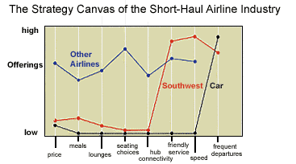
MMA 801 – Session 4

Slide 39
MMA 801 – Session 4
Litmus Test – Value Curve Repositioning Conclusions
Utility
Is there exceptional utility in the redefined value curve?
Price
Is there an available price corridor (low, mid-level, Upper) for success?
Cost
Can target costs be met?
Adoption
Does enough scale exist to meet target profits?

Slide 40
Analytics and Granulation in Marketing

Slide 41
MMA 801 – Session 4
Concept of Granulation
Granulation – Market Focus
Means understanding the world at the level of individual customers and transactions
The ultimate segment is a segment of "1"
It is drilling down a "mega trend" in a way which will generate demand
It is understanding "demand categories" below broad product/service categories
In the context of Marketing – We use granulation to assist in reinforcing and/or disrupting existing behavior patterns.

Slide 42
MMA 801 – Session 4
How to Influence – Reinforce or Change Purchase Behaviour
Company Performance Below Expectations
Initial Consideration Set…Pre-determined purchase order
Active Option Evaluation
Purchase Decision
Post Purchase Performance and Future Decisions
1. Influencers
Company Driven Marketing
Past Experience
Consumer Driven Marketing
Channel Interaction
2. Influencers
Consumer Driven Marketing
Channel Interaction
Company Driven Marketing
Past Experience
3. Influencers
Channel Interaction
Consumer Driven Marketing
Company Driven Marketing
Past Experience
Committed Customer

Slide 43
MMA 801 – Session 4
What Do Customers Expect?
They want to interact anywhere at any time.
They want to do new things as technology creates more effective ways to create value for them.
They expect data collected about them will be used to precisely identify their needs and personalize their experience.
They expect all interactions to be easy.

Slide 44
MMA 801 – Session 4
Drive Behavioural Data
Map the Customer Journey
Consideration, purchase, use, and repeat purchase/use… Touch points
Understand and Track Customer Signals
Information relating to needs or intentions…trigger points for reinforcement
Processes, People, Technology
Identify customers with similar behaviour and needs
Personalization Fundamentals
Effectively deliver triggers

Slide 45
MMA 801 – Session 4
Personalization requires
Telescope
Clear view of broad trends with respect to your market, category and brand
Microscope
Clear understanding of how to show customers they matter. Laser focus on aligning needs, products, to personalized customer journey.
Binoculars
Clear, integrated view of how your company integrates customer-facing functions to support Customer Decision Journey
Making data and discovery a nonstop cycle
Immediate, valuable, relevant, simple

Slide 46
MMA 801 – Session 4
Identify customer behaviours which creates value…highest payouts
Develop a hypothesis about which customer outcomes matter most…build model
Analyze customers identified as satisfied, neutral, and dissatisfied…as a result of this model
Look at the trends to develop a forward-looking view
If this…then that…set priorities for key areas to improve
Track trends based on metrics developed and adjustments made…are you unlocking the value?
Building The Payout Model
Feedback Loop

Slide 47
MMA 801 – Session 4
A Key to driving granulated-based Portfolio Momentum – Analytics
Purchase Criteria Mapping
How do purchasers make decisions?
What situational factors affect their choices?
What needs are they trying to meet and during what times?
What is the relative importance of various product benefits and attributes in the purchase decision?
What drives purchaser "switching" behaviour

Slide 48
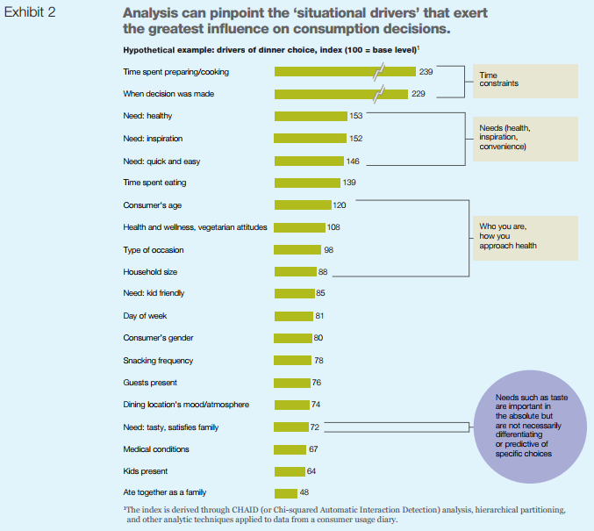
MMA 801 – Session 4
The key is to identify "white spaces" not currently being focused on by the company and its portfolio.
Mattresses…technological claims… no…comfort and restfulness…yes.
Common medicines – caplets, gels, capsules, tablets… customer is indifferent.
Pain relievers…active ingredients (aspirin, ibuprofen)…no…symptoms (head pain, body pain, etc.)…yes.
Source: Market Map: Doucette, Holsztejn, Kuijpers

Slide 49
MMA 801 – Session 4
Granulation and Risk
Having said this…is there a risk of over-granulation? If so, what is it?
What are the potential consequences of over-granulation?

Slide 50
Risk of Over-Granulation
MMA 801 – Session 4
Product Portfolio Impact
Pain Relievers
Cold & Cough
Flu
Arthritis
Sinusitis
Night-Time Remedies
Liquids
Caplets
Tablets
Capsules
Gel Tabs
Nasal Sprays
Other
5 x 6 = 30 products, with variety of sizes, easily 100+ SKUs
Potential Risk of:
Reduced size and scale
Diseconomies of scope and scale
Cannibalization
Customer confusion, over-complexity
Margin erosion
As you granulate…you narrow scope and size
Have you eroded KVCs and KVIs (key value categories and key value items?)

Slide 51
MMA 801 – Session 4
Strategy Execution – Mature Markets
Cost/Benefits
Granularity Cost Curve
Granularity Benefit Curve
Maximum net benefit of granularity
Granularity
Sweet Spot

Slide 52
MMA 801 – Session 4
The Strategic Litmus Test
Have you identified the real drivers of profitability?
Do customers know why they need you?
Are you reaching the right decision-maker with the right message?
Do customers believe your claims?
Are our employees working hard at the right things?
Is there a true "fit" between strategy, infrastructure and culture?

